Slide 1
Finding the prospects of opening an Indian restaurant in Toronto

Slide 2
Finding the business prospects is valuable
Toronto has a high percentage of Indian immigrants. Therefore, there is a great demand for Indian cuisine which makes Toronto a favorable place to open an Indian restaurant
This project:
Helps business owners select the most favorable location from a business standpoint
Lays the foundation for other data scientists for further geospatial analysis on such topics
Acts as a tool for Indian tourists to find a popular place to eat Indian food in Toronto

Slide 3
Data acquisition and cleaning
Information on Toronto’s neighborhoods (Postal code, borough, name of neighborhood) from https://en.wikipedia.org/w/index.php?title=List_of_postal_codes_of_Canada:_M&oldid=1012118802
Geographical coordinates of neighborhoods from https://cocl.us/Geospatial_data%E2%80%9D
Foursquare API used to collect Information about venues in Toronto such as name, category, latitude, and longitude (https://developer.foursquare.com/docs/)
Demographics of Toronto’s neighborhoods by ethnicity scraped to an insight into the distribution of Indians in Toronto and help identify neighborhoods where opening an Indian restaurant can attract most customers (https://en.m.wikipedia.org/wiki/Demographics_of_Toronto#Ethnic_diversity)
Cells which were not assigned a borough were dropped
Cells which were not assigned a neighborhood were given the same neighborhood name as their borough name

Slide 4
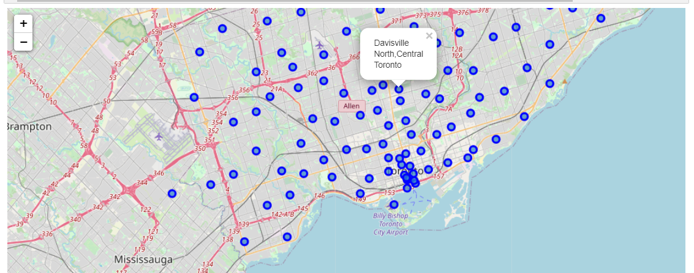
Leaflet map of Toronto Neighborhoods

Slide 5
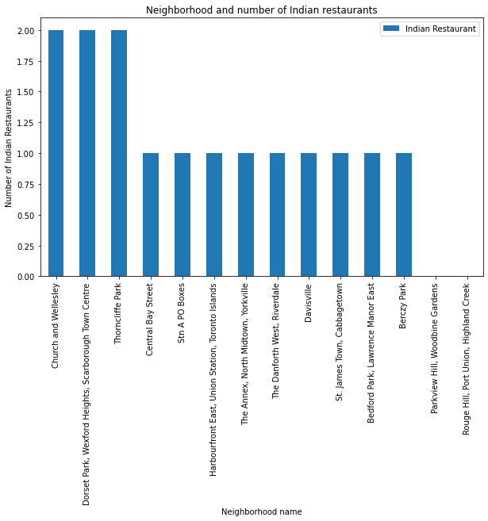
Bar chart - Neighborhood and Indian restaurant

Slide 6
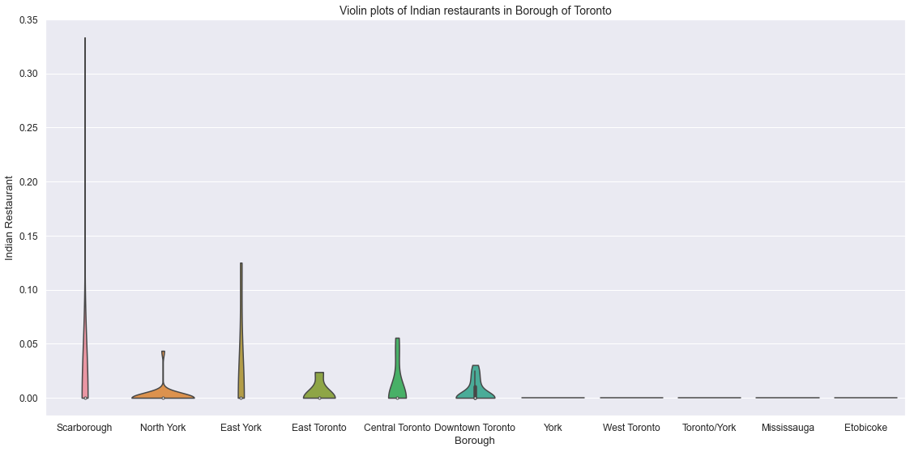
Violin plot - Neighborhood and Indian restaurant
We can see that Scarborough, North York, East York, East Toronto, Central Toronto and Downtown Toronto Borough have a high density of Indian restaurants

Slide 7
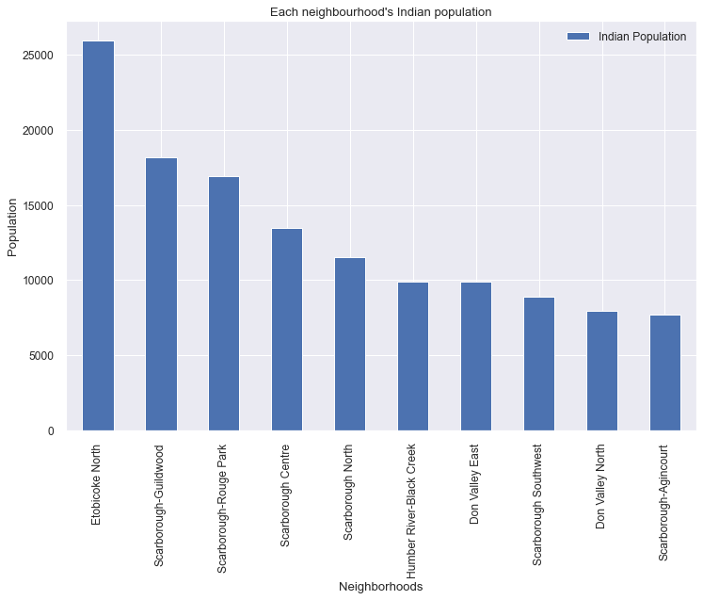
Distribution of Indian population

Slide 8
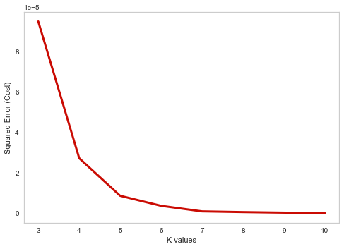
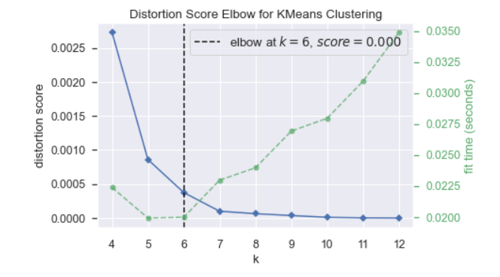
K-means classification model
After analyzing the squared error and elbow distortion score, I decided that K=6 will be the best value for our analysis

Slide 9
Conclusions and future directions
Built useful models which helps businesses evaluating the success of an Indian restaurant in Toronto
Also benefits multiple other stakeholders
This tool can be tweaked a bit and applied to different venues for different locations
Accuracy of the model has room for improvement
Can take additional metrics such as reviews and ratings to determine the success of a restaurant

